Slide 1
Kubernetes Deep Dive Updated 5 Feb 2020

Slide 2
Kubernetes > Agenda
Big picture
Basics
Primitives
Development
Q&A
Networking

Slide 3
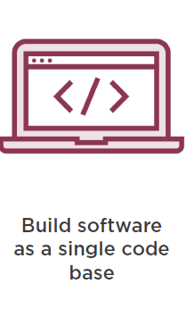
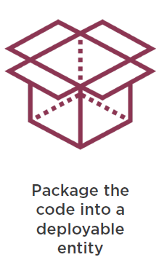
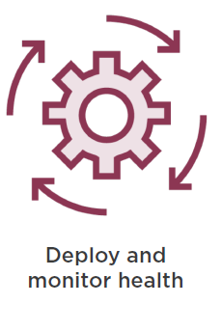

Kubernetes > Big Picture > Traditional Software Development

Slide 4
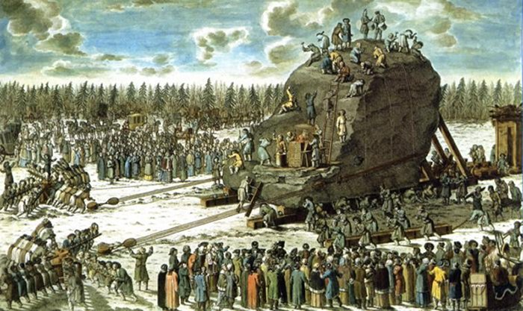
Kubernetes > Big Picture > Traditional Software Release

Slide 5
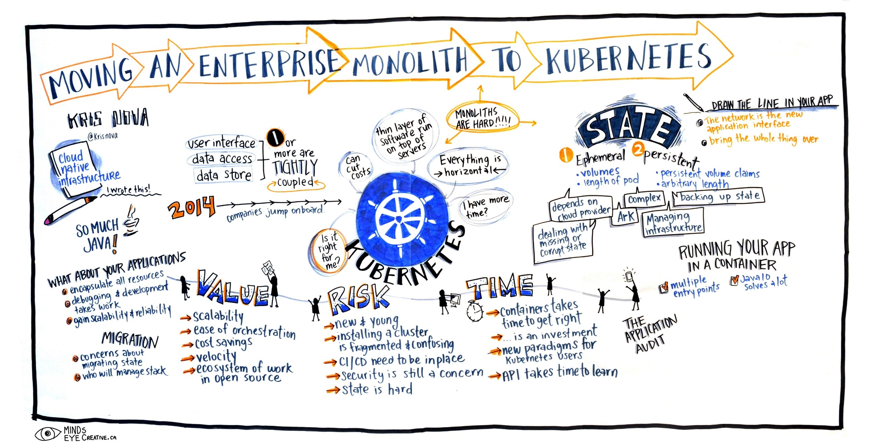
Kubernetes > Big Picture > A better way?

Slide 6
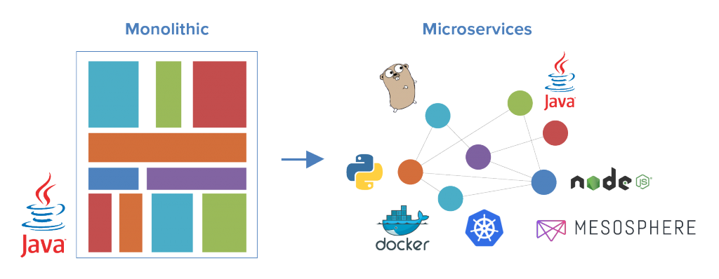
Kubernetes > Big Picture > Monolith-2-Microservices

Slide 7
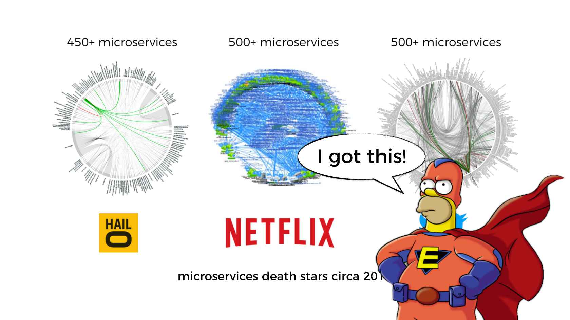
Kubernetes > Big Picture > Microservices

Slide 8
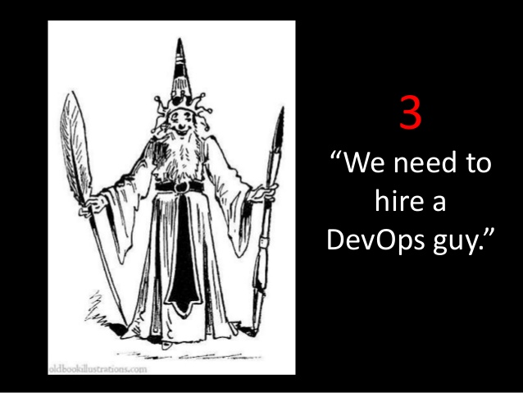
Kubernetes > Big Picture > DevOps

Slide 9

Kubernetes > Big Picture > DevOps > Challenge

Slide 10
Kubernetes > Big Picture > DevOps > Proposal
We need automation, which includes automatic scheduling, automatic configuration, supervision, and failure handling

Slide 11
Kubernetes > Big Picture > DevOps > Solution

Slide 12
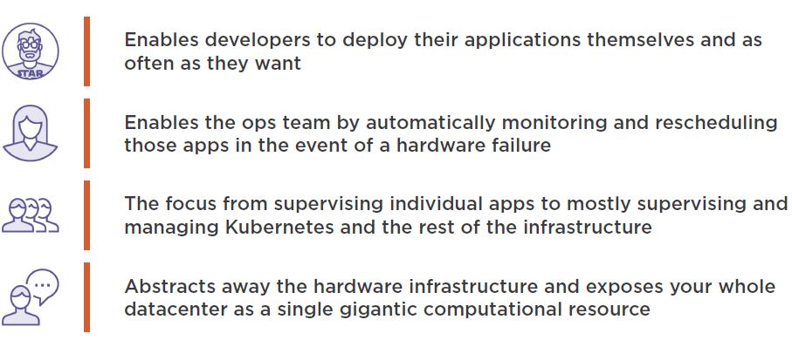
Kubernetes > Big Picture > Benefits

Slide 13

Kubernetes > Basics

Slide 14
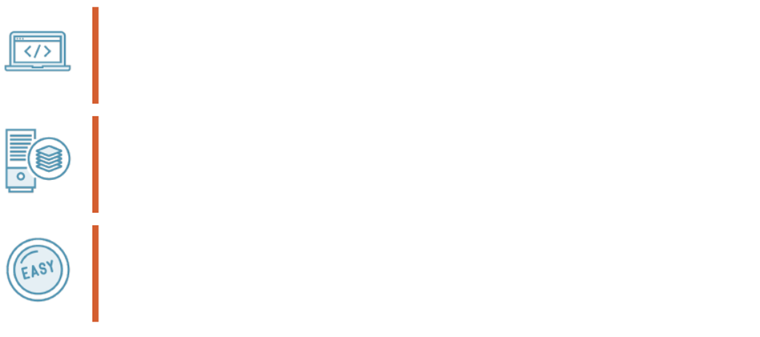
Kubernetes > Basics > What is the goal of k8s?
To provide a platform that allows you to easily deploy and manage containerized applications
To expose your organizations IT infrastructure as a single computational resource
To ensure a consistent deployment experience regardless of the size of the cluster

Slide 15
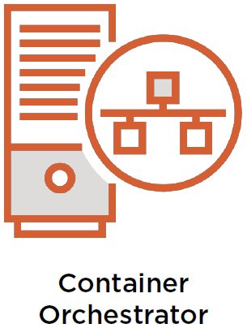

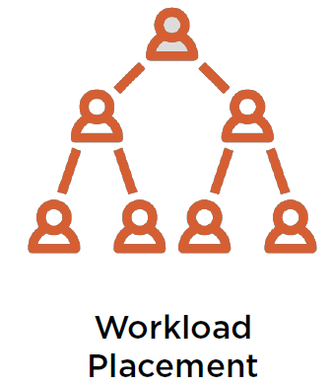
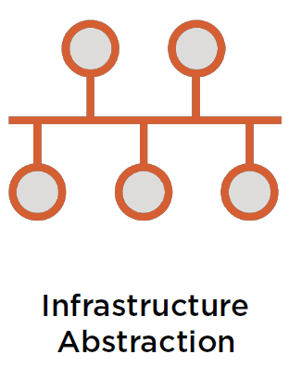
Kubernetes > Basics > How does k8s achieve its goal?
A key facet of k8s is workload placement to control how, when and where containers are deployed.
k8s maintains your desired state configuration in code and leaves it for the platform to ensure that the system meets that desired state.
K8s core responsibility is to orchestrate container-based applications.
K8s provides infrastructure abstraction (networking, storage, etc).

Slide 16
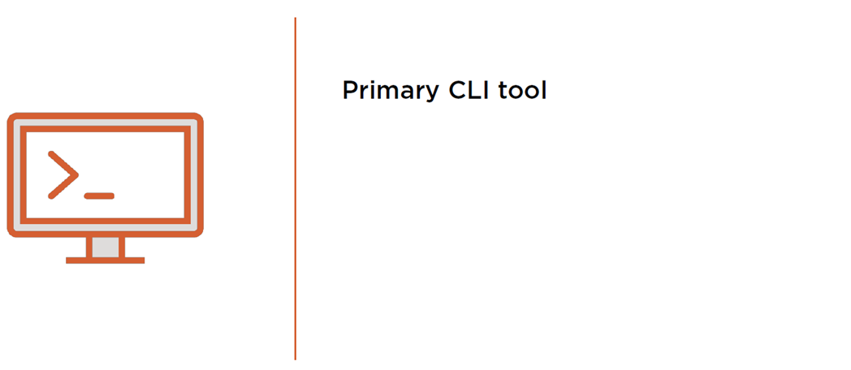
Kubernetes > Basics > kubectl
Operations – what you want to do
Resources – what you want to do it to
Flags – optional behaviors
E.g. kubectl get pods --show-labels
https://kubernetes.io/docs/reference/kubectl/cheatsheet/

Slide 17

Kubernetes > Basics > kubectl > Demo

Slide 18

Kubernetes > Basics > Namespaces
Most k8s resources (e.g. pods, services, etc) are in some namespace. However namespace resources are not themselves in a namespace and low-level resources, such as nodes and persistent volumes, are not in any namespace
Namespaces provide a scope for names. Names of resources need to be unique within a namespace, but not across namespaces. Namespaces can not be nested inside one another and each Kubernetes resource can only be in one namespace
Namespaces are a way to divide cluster resources between multiple users (via resource quotas)
In future versions of Kubernetes, objects in the same namespace will have the same access control policies by default

Slide 19
Kubernetes > Basics > Namespaces > Demo

Slide 20
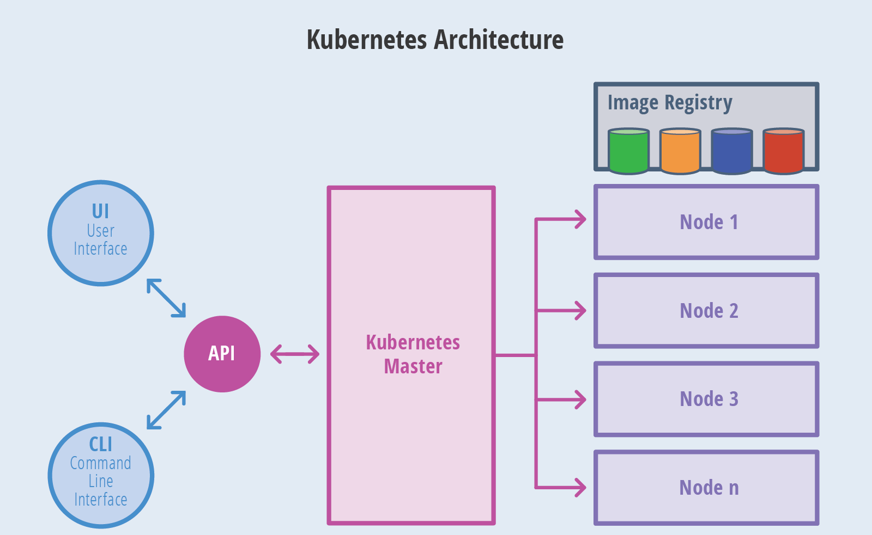
Kubernetes > Basics > Architecture

Slide 21
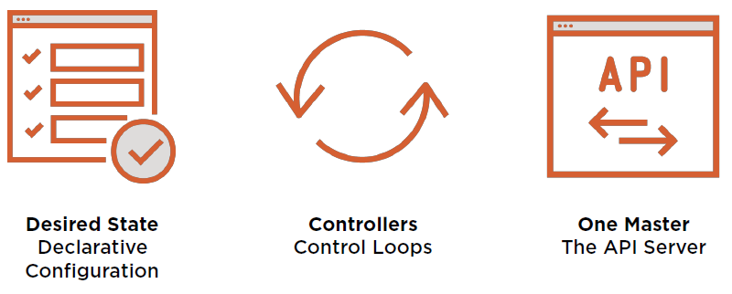
Kubernetes > Basics > Core Principles

Slide 22

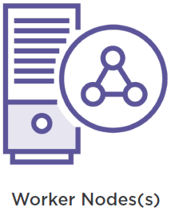
Kubernetes > Basics > Node Types

Slide 23
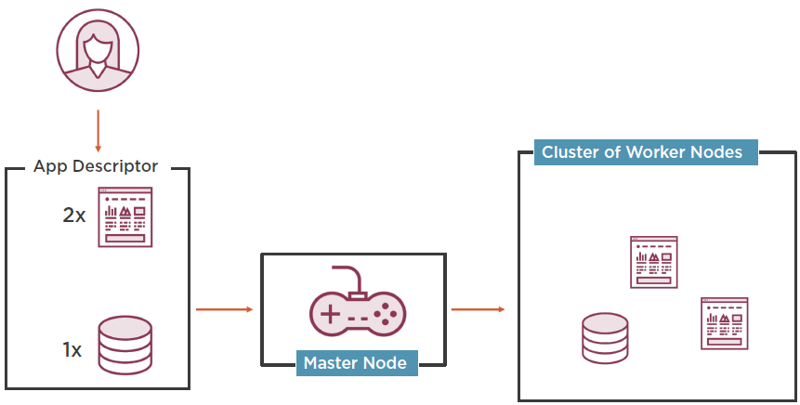
Kubernetes > Basics > System Overview
Developer applies yml manifest(s)
Worker nodes run application containers and communicates changes back to master node via local kubelet.
Master node looks at the yml manifest(s) and schedules applications for worker nodes.

Slide 24
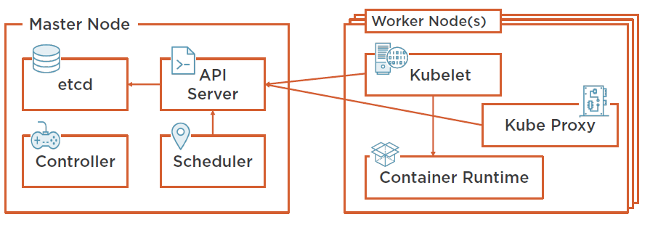
Kubernetes > Basics > Cluster Architecture
Communicates with API server and manages containers.
Load balances network traffic.
Cluster configuration.
RESTful API which acts as a communication hub for the cluster.
Cluster level functions. E.g. replication, tracking worker nodes, handling node failure, etc.
Assigns applications to work nodes.
Docker or rkt.

Slide 25
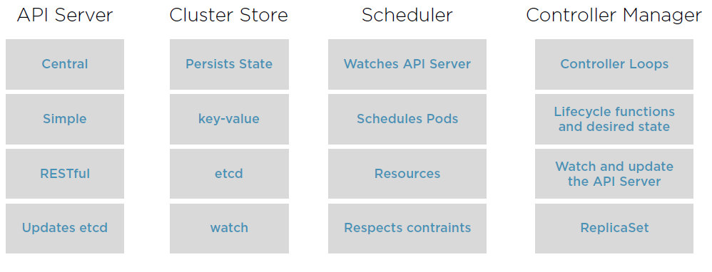
Kubernetes > Basics > Master Node Control Plane Components

Slide 26
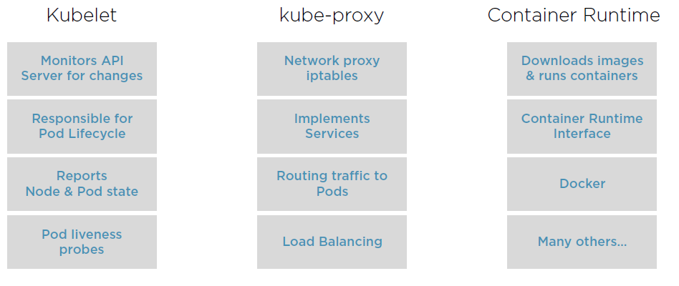
Kubernetes > Basics > Worker Node Control Plane Components

Slide 27
Kubernetes > Basics > Workflow
Package your application into one or more containers.
Push those images to an image registry.
Scheduler schedules containers on available worker nodes.
Post yml manifests to the k8s API Server.
Kubelet instructs worker nodes to download container images.
Kubelet instructs worker nodes to run the containers.

Slide 28
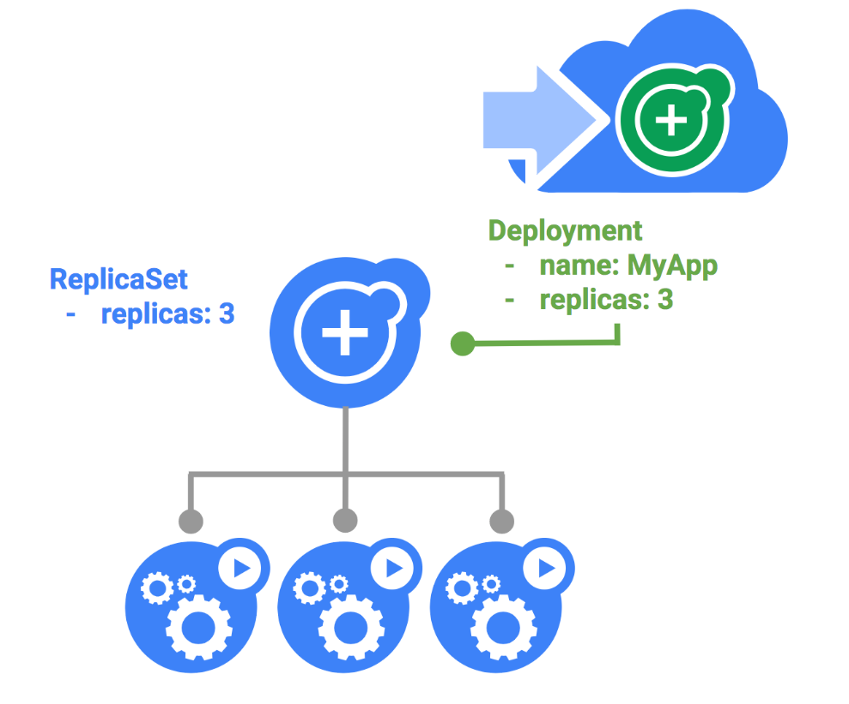
Kubernetes > Basics > Workflow > Deployments
Deployments allows us to rollout pods via ReplicaSets.
Deployments enabled migration between different pod versions at a controlled rate.
Deployments enable easy rollbacks if the current state of the Deployment is not stable. Each rollback updates the revision of the Deployment.

Slide 29
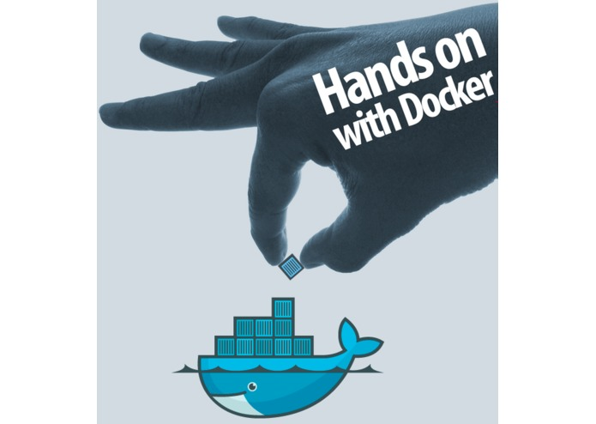
Kubernetes > Basics > Workflow > Deployments > Hands-on

Slide 30
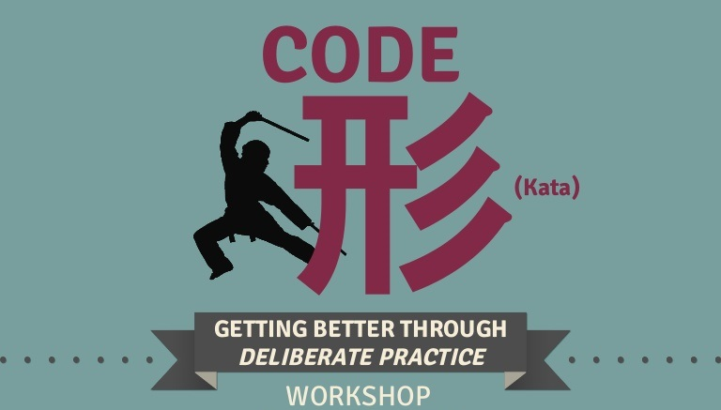
Kubernetes > Basics > Workflow > Deployments > Code Kata #1

Slide 31
Kubernetes > Basics > Benefits
Simplifies Application Deployment

Slide 32
Kubernetes > Basics > Benefits
Health Monitoring with Self-Healing
Automatic Scaling

Slide 33
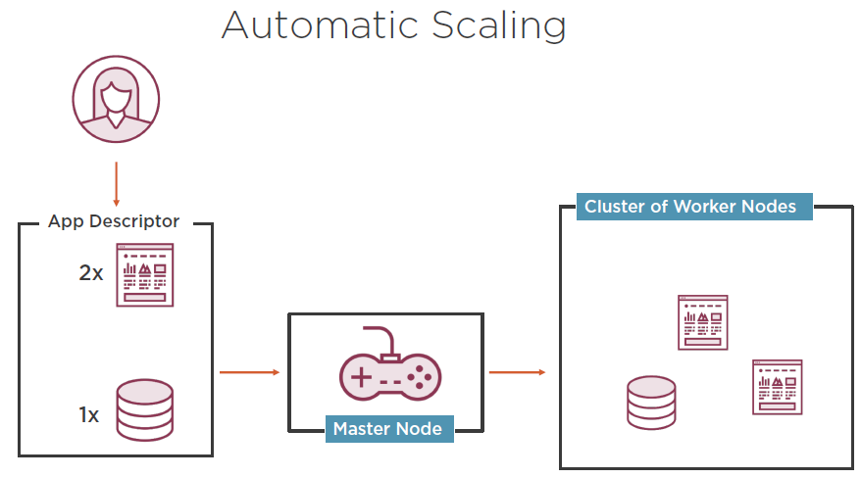
Kubernetes > Basics > Benefits
Health Monitoring with Self-Healing

Slide 34
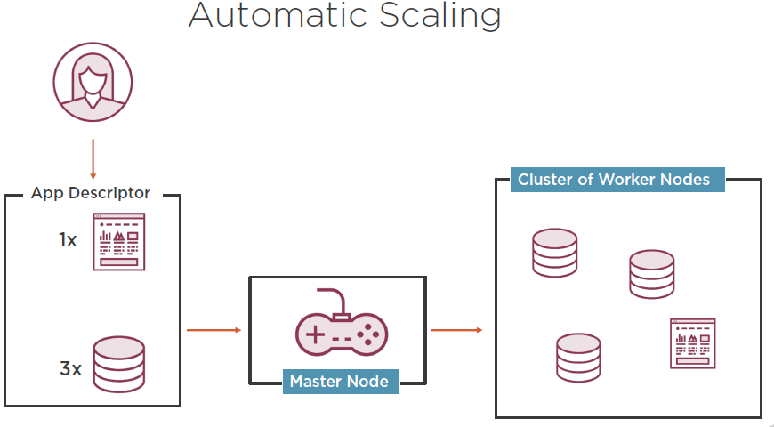
Kubernetes > Basics > Benefits
Health Monitoring with Self-Healing

Slide 35
Kubernetes > Basics > Benefits
Better Hardware Utilization

Slide 36
Kubernetes > Basics > Benefits
Health Monitoring with Self-Healing
Health Monitoring with Self-Healing

Slide 37
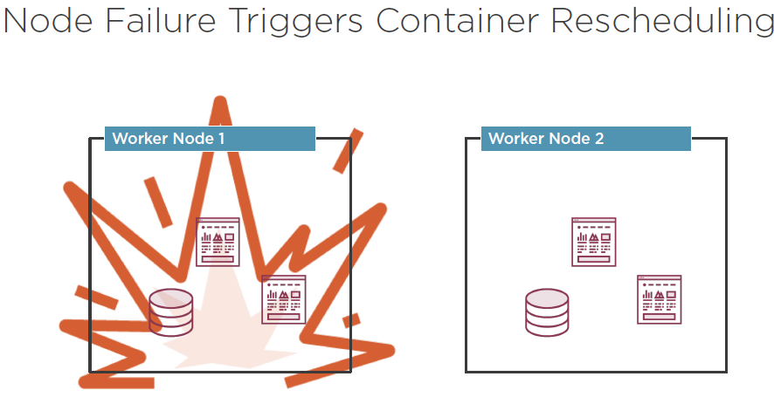
Kubernetes > Basics > Benefits
Health Monitoring with Self-Healing

Slide 38

Kubernetes > Basics > Q/A

Slide 39
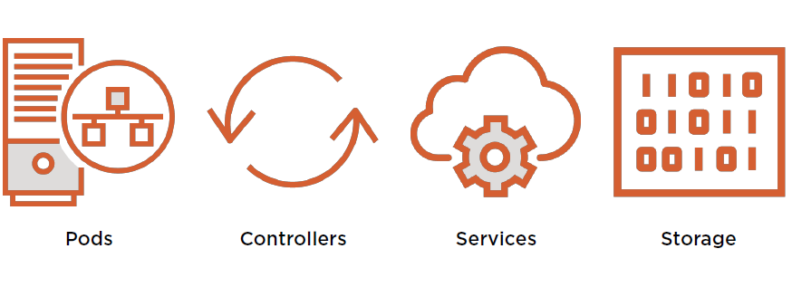
Kubernetes > Primitives

Slide 40
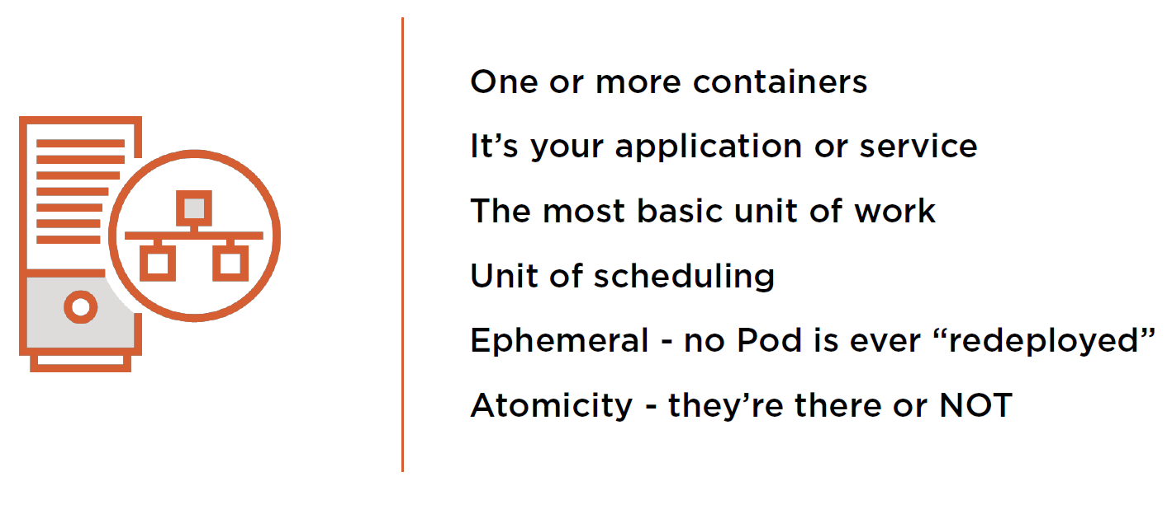
Kubernetes > Primitives > Pods

Slide 41
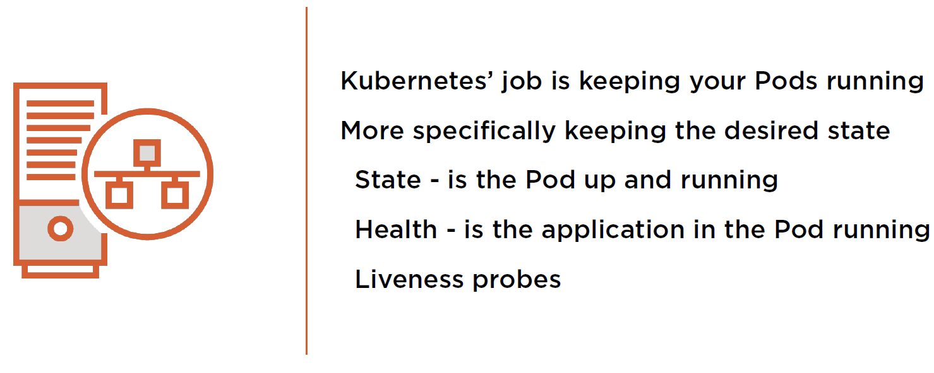
Kubernetes > Primitives > Pods

Slide 42
Kubernetes > Primitives > Pods > Hands-on

Slide 43
Kubernetes > Primitives > Pods > Code Kata #2

Slide 44
Kubernetes > Primitives > Controllers
So how does Kubernetes
manage your Pods’ state?

Slide 45
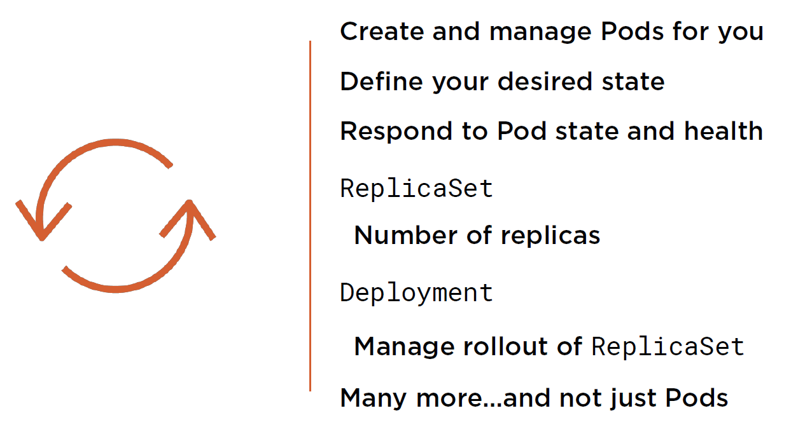
Kubernetes > Primitives > Controllers

Slide 46
Kubernetes > Primitives > Services
So how does Kubernetes add
persistency to all this ephemerality?

Slide 47
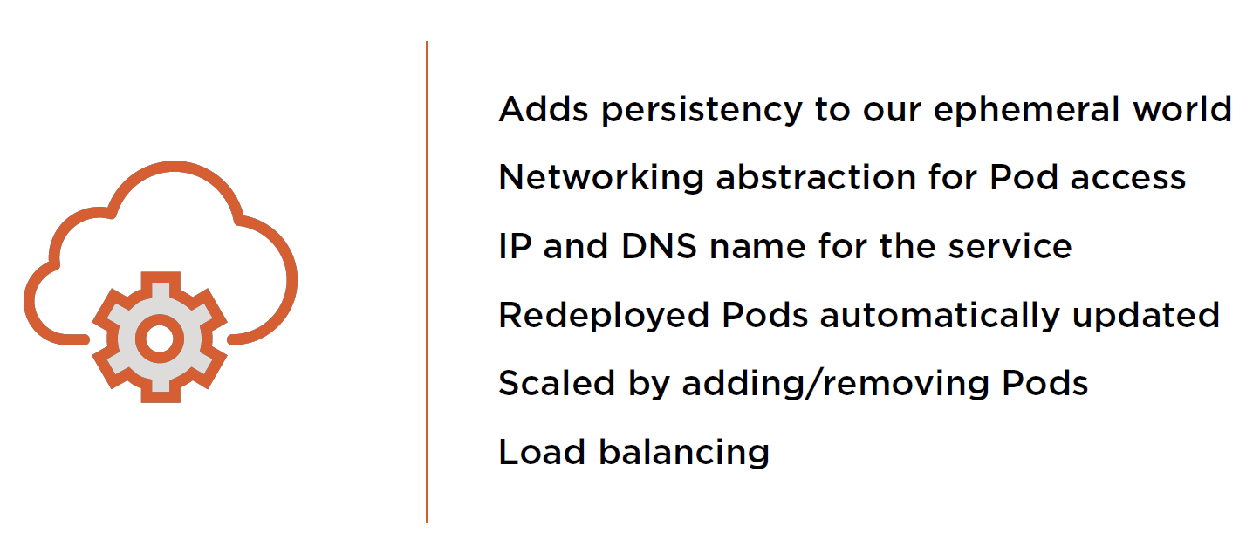
Kubernetes > Primitives > Services

Slide 48
Kubernetes > Primitives > Services > Hands-on

Slide 49
Kubernetes > Primitives > Services > Code Kata #3

Slide 50
Kubernetes > Primitives > Storage
What about my data?
Where’s that stored in Kubernetes?

Slide 51
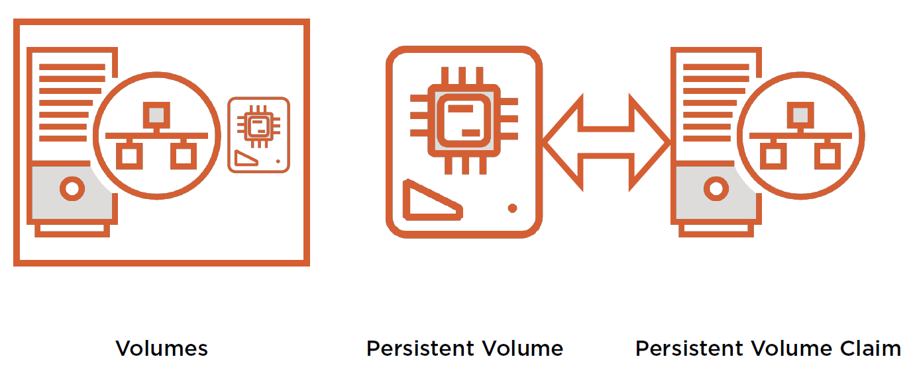
Kubernetes > Primitives > Storage

Slide 52
Kubernetes > Primitives > Storage > Hands-on

Slide 53
Kubernetes > Primitives > Storage > Code Kata #4

Slide 54
Kubernetes > Primitives > Q/A

Slide 55
Kubernetes > Networking
So how does Kubernetes connect all these objects?

Slide 56
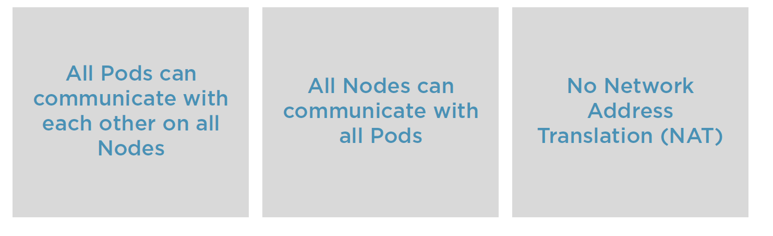
Kubernetes > Networking > Principles

Slide 57


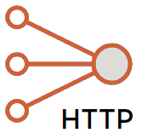
Kubernetes > Networking > Scenarios
Pod
Pod
IP
IP
Bridge
Kube-proxy
Pod
Layer 2 or 3
Inside a Pod.
Pod to Pod within a node.
Pop to Pod on another node.
External service.
Service
localhost
Pod
Kube-proxy
IP

Slide 58
Kubernetes > Networking > Hands-on

Slide 59
Kubernetes > Networking > Code Kata #5

Slide 60
Kubernetes > Networking > Q/A

Slide 61
Kubernetes > Development
ConfigMaps
Secrets
Resources
Probes
Debugging

Slide 62
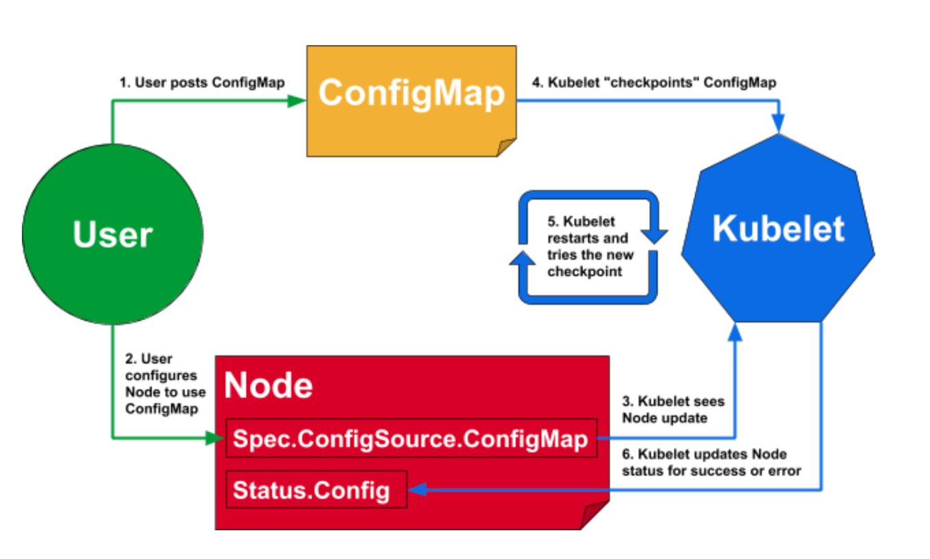
Kubernetes > Development > ConfigMaps

Slide 63
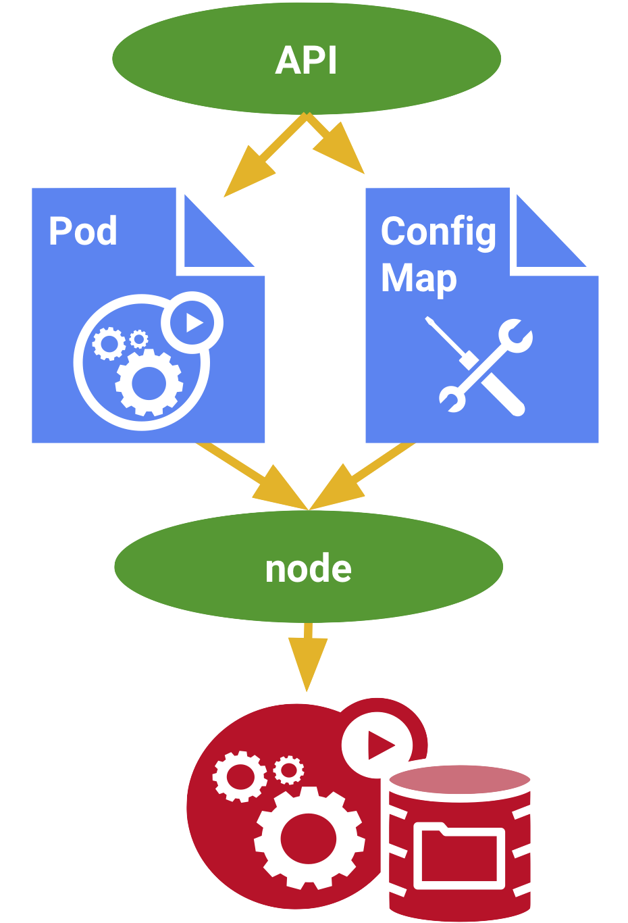
Kubernetes > Development > ConfigMaps > Creating
apiVersion: v1
kind: ConfigMap
metadata:
name: my-config-map
data:
myKey: myValue
anotherKey: anotherValue

Slide 64
Kubernetes > Development > ConfigMaps > Consuming
apiVersion: v1
kind: Pod
metadata:
name: my-configmap-pod
spec:
containers:
- name: myapp-container
image: busybox
command: ['sh', '-c', "echo $(MY_VAR) && sleep 3600"]
env:
- name: MY_VAR
valueFrom:
configMapKeyRef:
name: my-config-map
key: myKey

Slide 65
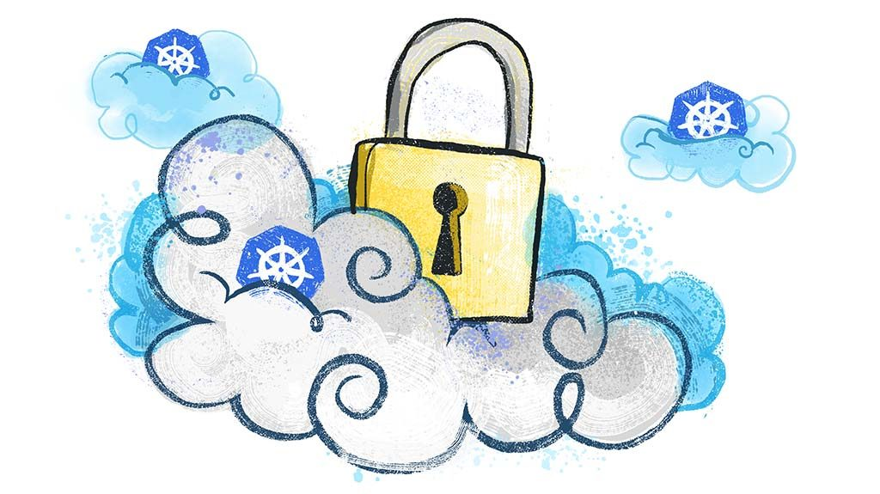
Kubernetes > Development > Secrets

Slide 66
Kubernetes > Development > Secrets
K8s Secrets are a way to store confidential information. They are used by Pods, the kubelet, and the system itself
Secrets can be created through the command line as well as through definition files.
To enable containers to access Secrets, you have the option to mount them as a volume or environment variables.
The kubelet uses Secrets when it needs to pull images from private image registries that require authentication using the imagePullSecrets parameter.

Slide 67
Kubernetes > Development > Secrets > Hands-on

Slide 68
Kubernetes > Development > Secrets > Code Kata #6

Slide 69
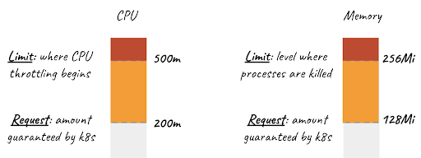
Kubernetes > Development > Resources > Requests and limits
Resources are controlled at the container-level of a Pod by specifying one or more of the following:
spec.containers[].resources.limits.cpu
spec.containers[].resources.limits.memory
spec.containers[].resources.limits.hugepages-<size>
spec.containers[].resources.requests.cpu
spec.containers[].resources.requests.memory
spec.containers[].resources.requests.hugepages-<size>

Slide 70
Kubernetes > Development > Resources > CPU units
Limits and requests for CPU resources are measured in cpu units. One cpu, in k8s, is equivalent to:
1 AWS vCPU
1 GCP Core
1 Azure vCore
1 IBM vCPU
1 Hyperthread on a bare-metal Intel processor with Hyperthreading

Slide 71
Kubernetes > Development > Resources > Memory units
Limits and requests for memory are measured in bytes. You can express memory as a plain integer or as a fixed-point integer using one of these suffixes: E, P, T, G, M, K. You can also use the power-of-two equivalents: Ei, Pi, Ti, Gi, Mi, Ki. For example, the following represent roughly the same value:
128974848 == 129e6 == 129M == 123Mi

Slide 72
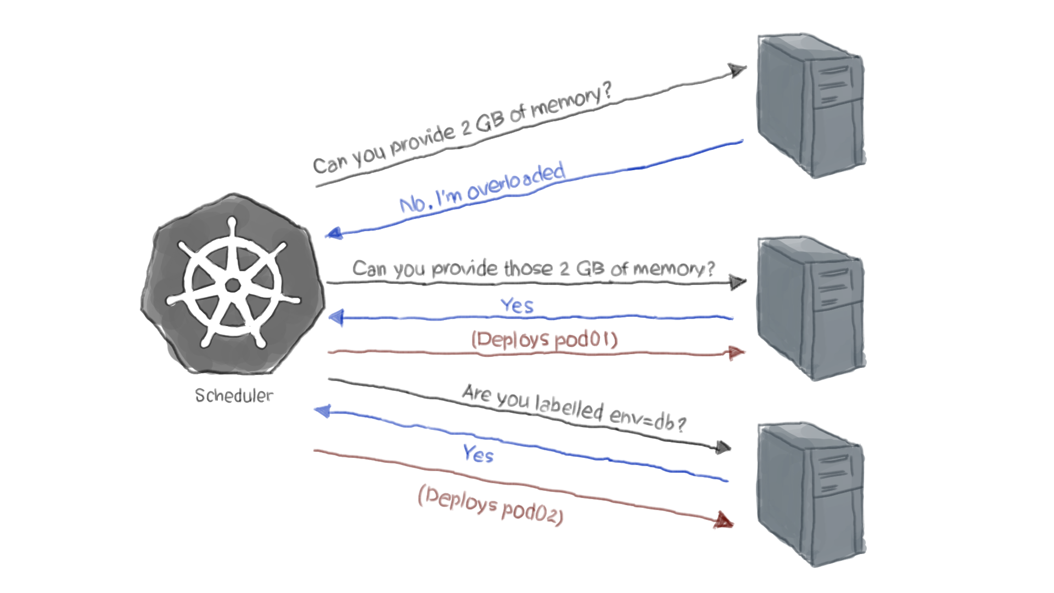
Kubernetes > Development > Resources > Pod scheduling

Slide 73
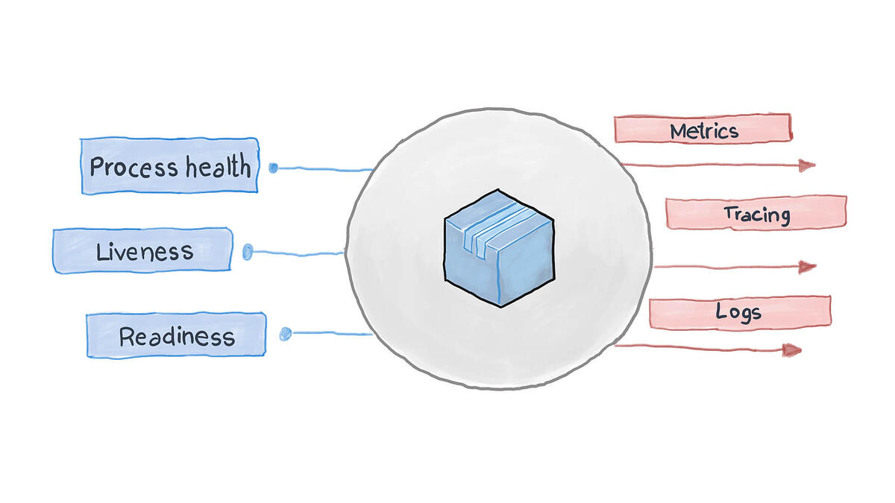
Kubernetes > Development > Probes

Slide 74
Kubernetes > Development > Probes > High-observability principle
Logs and basic metrics are not enough to achieve high-observability of your containers and microservices
For faster recovery and higher resilience applications must apply the High Observability Principle (HOP)
HOP at application level requires: proper logging, detailed monitoring, health probes, and (performance/logical) tracing
Use Kubernetes readinessProbe and the livenessProbe as part of high-observability principle

Slide 75
Kubernetes > Development > Probes

Slide 76
Kubernetes > Development > Probes > Hands-on

Slide 77
Kubernetes > Development > Probes > Code Kata #7

Slide 78
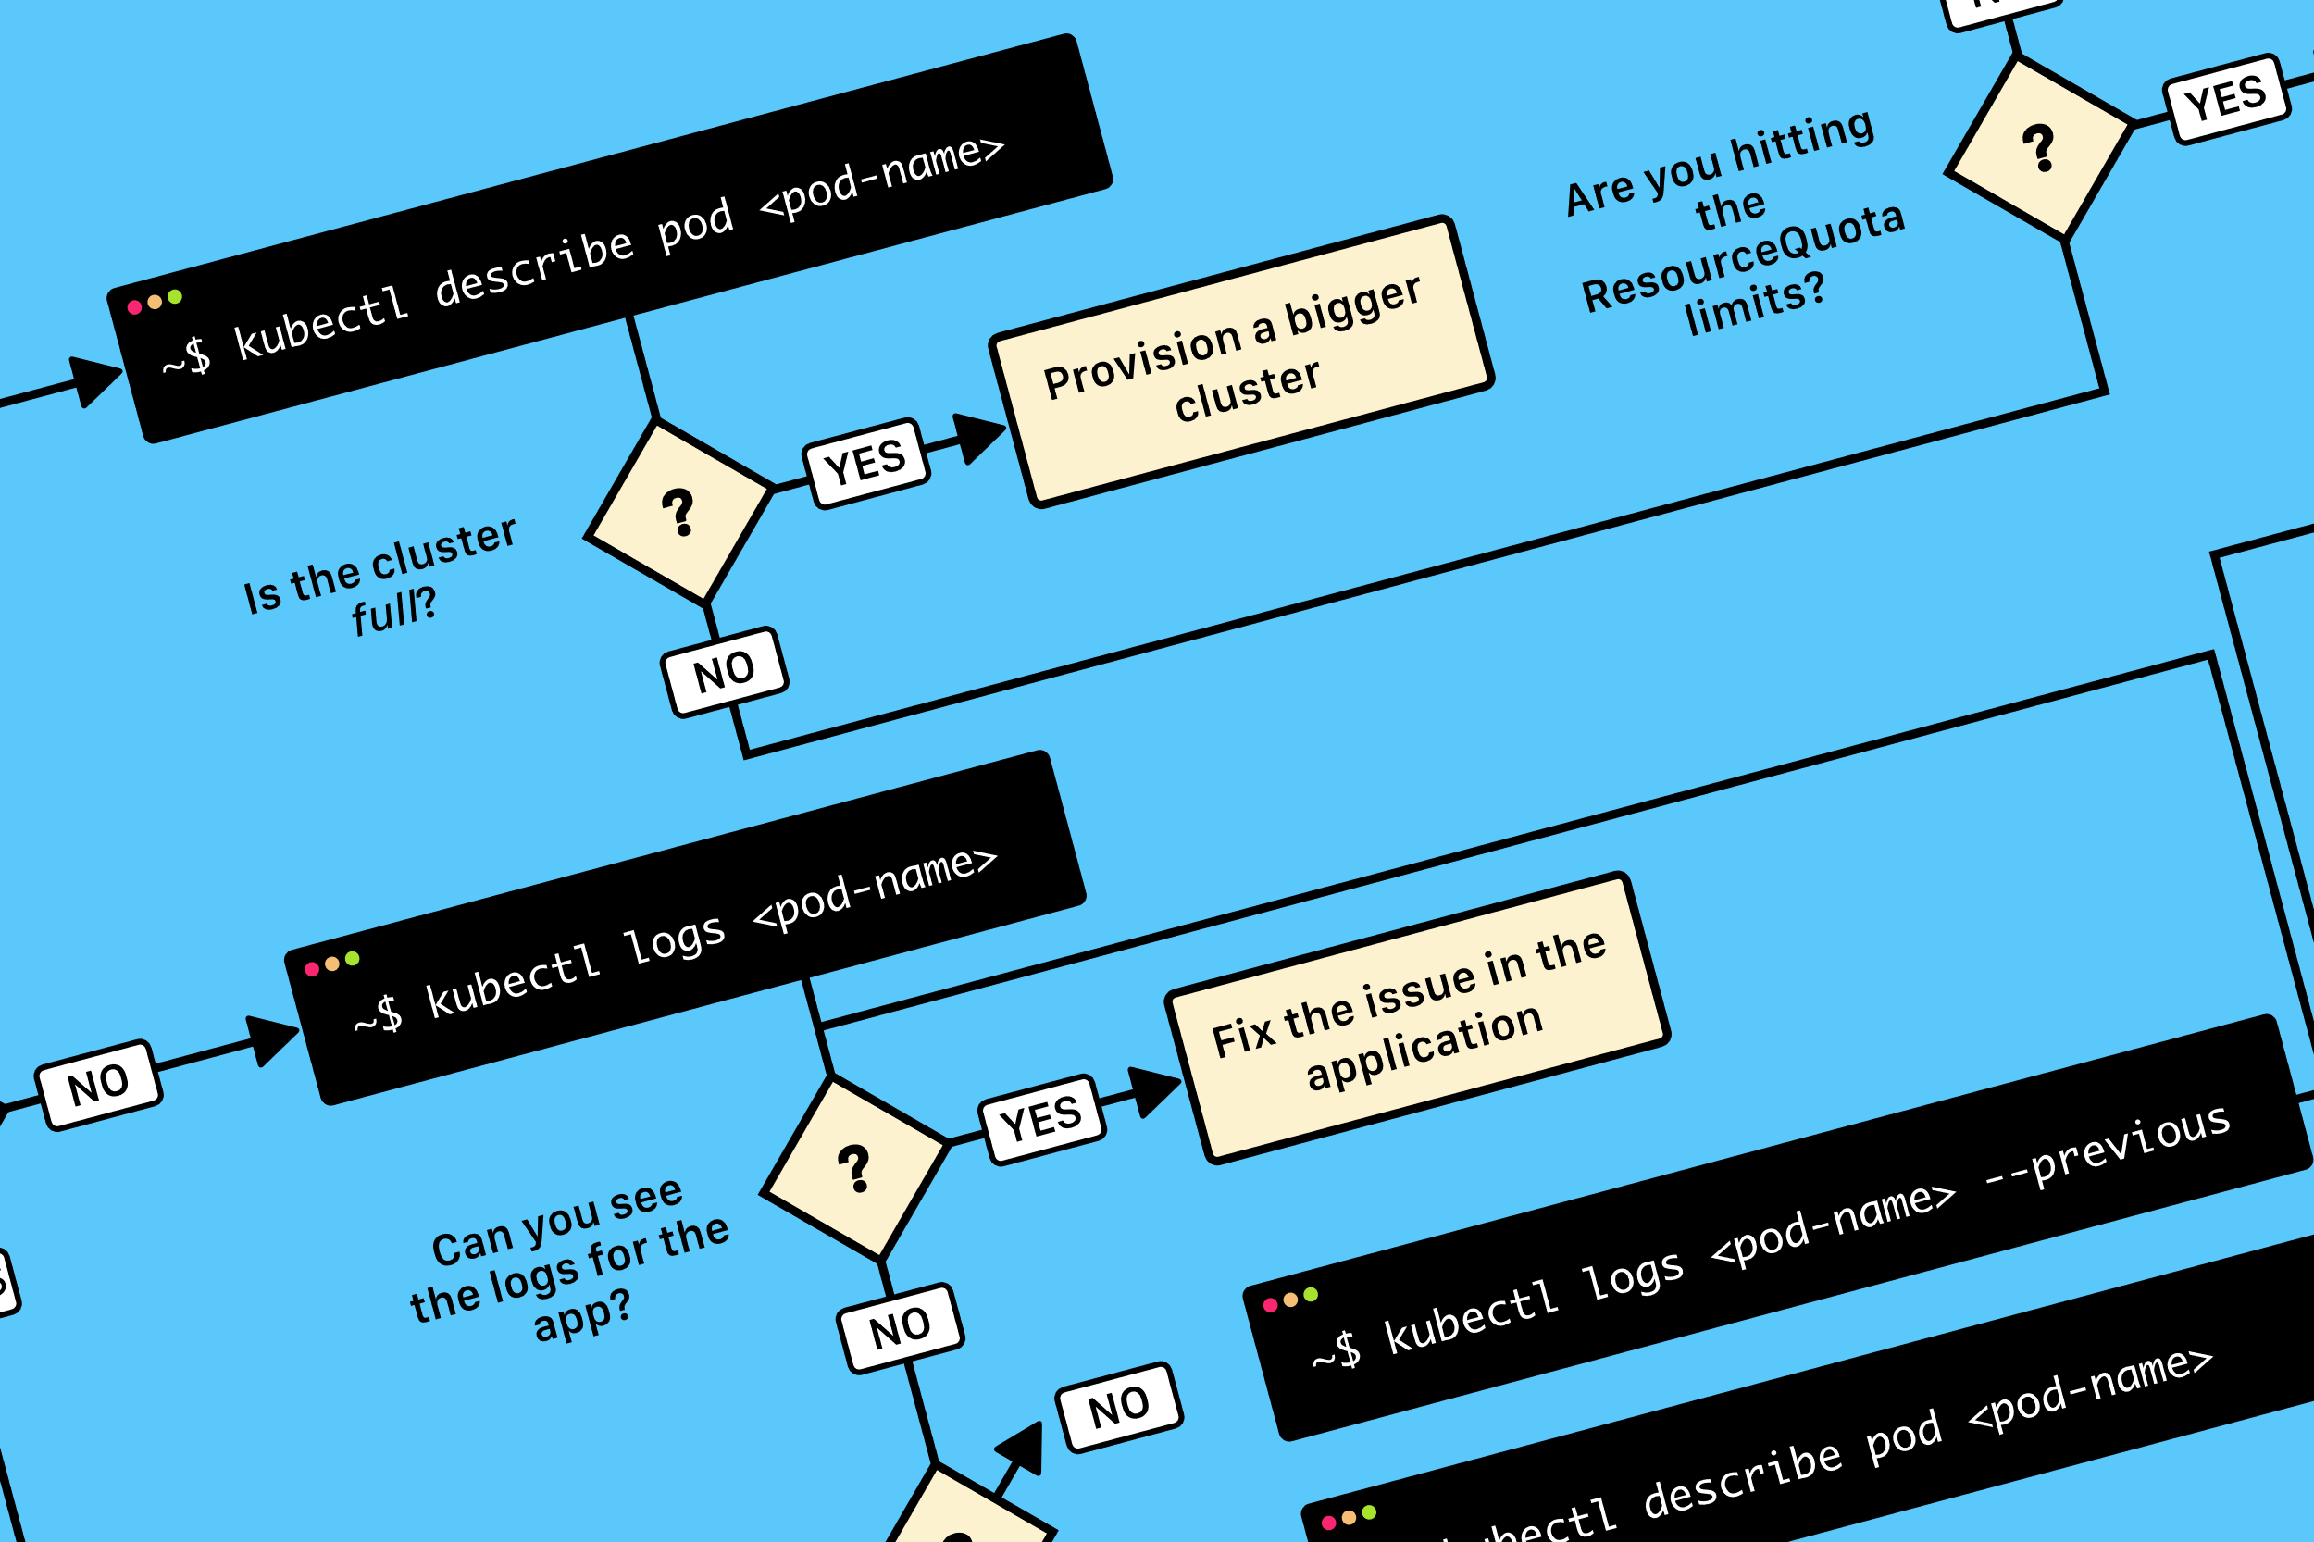
Kubernetes > Development > Debugging > 5 simple steps
Locate broken pod
Export broken pod summary
Export broken pod logs
Apply patch to broken pod
Ensure broken pod is in desired state

Slide 79
Kubernetes > Development > Debugging > Hands-on

Slide 80
Kubernetes > Development > Debugging > Code Kata #8

Slide 81
Kubernetes > Development > Q/A

Slide 82
Kubernetes > Feedback
https://forms.office.com/Pages/ResponsePage.aspx?id=ZpSpcwWtIUKfkOcUKqL2wTFclz-gNvpNq3THAj1j3ZxUODk1TjlEWVNJNzUxNjAwTFhGQkQ2VkNTWi4u

Slide 83
Kubernetes > Literature
http://kubernetes.io/
https://hackernoon.com/why-and-when-you-should-use-kubernetes-8b50915d97d8
https://medium.com/@tobiasandersen_76887/dfds-ded-k8s-s1e1-9685f38cbaef
https://medium.com/@tobiasandersen_76887/dfds-ded-k8s-s1-e2-6dadce6e8725

